Slide 1
Stelly’s Teaching Kitchen Cleaning 101

Slide 2
Custodial Cupboard
Chemical Storage
Floor, Pots + pans, Sanitizer, Degreaser cleaners
Floor Cleaner
Mop, bucket,
Broom, dustpan
Ladder
Extra cleaning pads

Slide 3
Custodial Cupboard
Storage for all types of cleaning equipment and cleaners
What do you see?

Slide 4
Floor Bucket + Mop

Slide 5
Sweeping Anyone?
Whoops, I made a mess of the Floor
Use a broom and a dust pan

Slide 6
Ladder
Ladders for reaching tall items
Big Brooms are for BIG cleaning

Slide 7
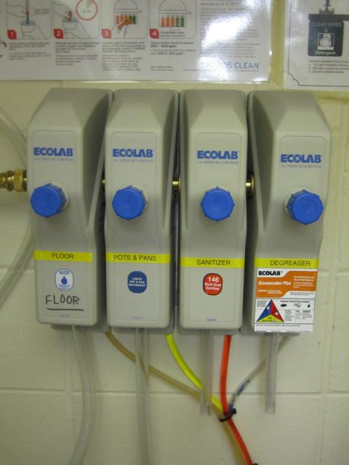
Cleaners Box
Floor detergent – for floor bucket and mop
Pots and pans
Sanitizer – for D10 sanitizing spray bottles
Degreaser – remove oil and grease from surfaces
Solutions are pre-mixed for convenience.
After dispensing it is very important to close taps!

Slide 8
Filling Up 101
Make sure the long hose is in the sink area and not outside
Why???
To prevent flood into the kitchen

Slide 9
Check Valves
One valve is pointed in the same direction as the hose ( parallel).
See the left valve? This will allow water to go through this hose.
The right valve is stopping water from going through the hose.
Notice the position of the valve.

Slide 10
Filling up continued…
Turn water on.
Check valves.
Place bucket or bottle under appropriate hose
Push button and portion cleanser

Slide 11
Commercial Dishwasher
#1 Scrape food scraps off bowls, plates, utensils,…
#2 Sort dishes for efficient cleaning and loading of dishwasher racks

Slide 12
Preparation – Presoak
#3 Presoak pans and utensils
Use presoaking cleanser
Recommend use of gloves for prolonged contact
This is a corrosive substance!

Slide 13
Preparation – Presoak
Fill presoaking buckets with HOT water and 15 ml of powder
Fill cooking pot or hotel pan with hot water and 5 ml of powder
Soak

Slide 14
Sharps
Place sharp objects in the red bucket
Knives
Food Processor Blades
Utensils (peelers…)
Can lids

Slide 15
Clean the Dishes
#4 Rinse and scrub
NO Garburator!
All equipment must be scrubbed clean before running through the dishwasher
Rinse using sprayer
Food scraps are caught in drainer

Slide 16
Entrée Sink - Cleaning
Double sink- for rinsing meat, cleaning pots, draining pasta
Small right sink - hand washing
Cleaning rags in the cupboard above the small sink
Cleaning soap in squeeze bottle on tray to the right of the rag cupboard
Cleaning buckets on floor to the left

Slide 17
Hand Washing Sink
Hand soap on wall
Paper towels
Squeeze bottle of pot and pan soap for cleaning work stations
Compost bucket under the sink
Garbage container

Slide 18
Cleaning Buckets
Buckets for cleaning work stations are never used for food
Fill half full with hot water and a squirt of pot and pan soap (concentrated)
Change water as frequently as needed – hot and soapy!

Slide 19
Work Station Cleaning 101
Use a clean rag and hot, soapy water
Wash all food particles and grease off all surfaces
Rinse and wring out rag and wipe surface again (no puddles or soap left behind)
Sanitize – spray with D10

