Slide 1
Strategic Plan 2022 – 2027
The Board of Education is committed to engaging with its communities to develop the 2022-2027 Strategic Plan for Saanich Schools.
The specific goals and strategies that are central to the Strategic Plan will be shaped by the district’s core values and beliefs, vision, philosophy, mission, and guiding principles, all of which create the framework for everything we do to support our learning community.
Notes:
October Staff Meeting & PAC Meeting
Selected Data Sources to be shared with staff ahead of your staff meeting (see Slide #4):
A summary of various provincial reports on student achievement in Saanich.
- Saanich Schools 2021-22 Framework for Enhancing Student Learning (FESL) Report with examples of local data.

Slide 2
Budget
A Strategic Plan is the District’s road map for action and future student success.
Provincial and local student achievement evidence inform us when determining the educational priorities.
A Strategic Plan is a critical part of the integration of district planning, budget priorities and operations.
Operations
Strategic Plan
Notes:
The Board is planning to have this Strategic Plan for 5 years so that there is an ability to track student progress on these themes over time.
The district will be submitting an annual FESL update report to the Ministry and adjusting the Strategic Plan as necessary.

Slide 3
Strategic Plan 2022-2027
Focus
Successful organizations are laser focused
Too Many Goals = Lack of Focus
Strong Strategic Plans are Evidence-based
Notes:
The most effective Strategic Plans are those that have a smaller number of goals that resonate with staff.
Our Strategic Plan should have themes that are student focused and geared towards all students. They are themes that have multiple evidence examples that show they are areas in need of improvement.
Themes are evidence-based and use data to track progress over time.

Slide 4
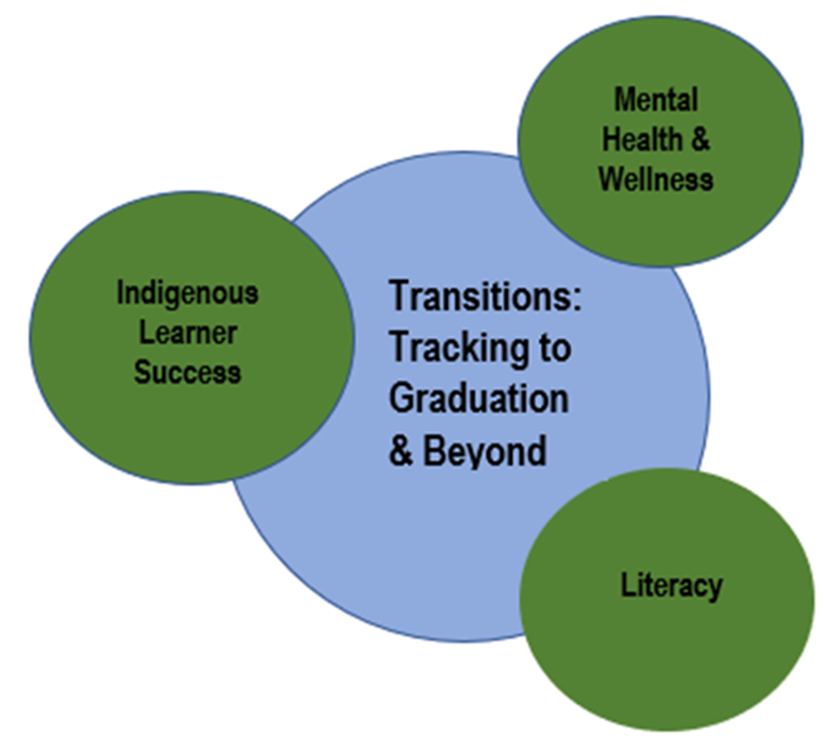
Strategic Plan 2022-2027
Evidence-based Focus Areas
Provincial Reports – Saanich School District
Saanich (63) Reports
Saanich Schools
Framework for Enhancing Student Learning (FESL)
September 2021
Notes:
Provide the links to staff if they want to view the provincial data for Saanich Schools as well as our recently released FESL Report
Grade-to-grade and level-to-level transitions are an important measuring instrument when gauging student success. They provide a useful lens, accompanied by other data sources, for tracing the student learning story in our district from Kindergarten through to graduation and beyond.
The Strategic Plan will track these transitions, as well as other data sources, to ensure that we monitor student progress in relation to the main areas of focus in the plan:
Literacy
Indigenous Learner Success
Mental Health and Wellness

Slide 5
Theme: Literacy
Rationale:
The correlation between student success and early literacy intervention is clear. It is essential that literacy instruction is prioritized.
Evidence Examples:
Report card data shows that elementary students are more likely to struggle in literacy versus numeracy
There is a lack of equity in the literacy data with some schools having more students who are emerging and needing support than others
Elementary teachers have identified literacy as a major focus
Current Initiative Example:
The district is working on a comprehensive K-12 literacy plan with an initial focus on early literacy in elementary grades to guide our direction over the coming years. This plan will include a focus on supporting consistent literacy practices, improving equity across our district, expanding literacy intervention strategies and supporting smooth transitions between grades and schools.

Slide 6
Theme: Indigenous Learner Success
Rationale:
The Truth and Reconciliation Commission has called for us to recognize our moral imperative to have an educational system where we address achievement gaps for Indigenous students – to engage in educational practices where we protect the right to Indigenous languages, where students do not encounter barriers or systemic racism, and graduate with dignity, purpose and options.
Evidence Examples:
Indigenous students are consistently not at parity with their non-Indigenous peers on academic measures
Although graduation rates continue to improve, they are not at parity with non-Indigenous students
We continue to receive feedback from Indigenous students and from the local communities that culture and language programs are essential for students
Current Initiative Example:
Based on community and student feedback, the district has placed a major focus on SENĆOŦEN language instruction. We now offer SENĆOŦEN at all levels (elementary, middle and secondary) and exposure to all kindergarten students in the district.

Slide 7
Theme: Mental Health & Wellness
Rationale:
Schools are the first step in the pathway of care, and they support mental health promotion by building resilience, creating supportive learning environments, and addressing barriers to positive mental health and wellness.
Evidence Examples:
McCreary Adolescent Health Survey:
1 in 5 students needed mental health services in the past year but had not accessed them
There was a noted increase in self-reported Mental Health conditions, particularly in females
Student Learning Survey (Gr 7, 10, 12)
Less than 50% of students responded positively when asked to describe their mental and physical health
Current Initiative Example:
The district will address mental health literacy through implementing specific curricular resources at the middle and secondary level and maintaining a continued focus on building professional capacity for all staff through in-service and other opportunities. Parent and community engagement will further enhance student learning by reducing stigma and supporting a greater understanding for students’ mental health and wellness.

Slide 8
Strategic Plan 2022-2027
Feedback Survey
The Board is working to build an evidence-based Strategic Plan that will help guide the district to even better student success.
We want your feedback on the draft focus areas you’ve just seen. You can provide your thoughts in a convenient e-survey on some or all of them.
There is also a place for you to offer additional thoughts on other areas to potentially explore, as the Board considers the creation of its new Strategic Plan.
We thank you for your time and suggestions.
STRATEGIC PLAN – CONSULTATION SURVEY
Notes:
Please provide your staff / parents with the link in an email, bulletin or other means. You may also want to consider sending this presentation to staff.
Dave E will be sending out an email to all staff and parents mid-October with the link, once schools have had these conversations.

